Slide 1
The committees of functional diversity in the 15M movement: reformulating disability activism in Spain
THE ORIGINAL PPT HAD MORE PICTURES BUT THEY HAVE BEEN REMOVED
IN ORDER TO AVOID POTENTIAL COPYRIGHT CONFLICTS.
MIRIAM ARENAS CONEJO Universitat de Barcelona.
ASUN PIÉ BALAGUER , Universitat Oberta de Catalunya.
ISRAEL RODRÍGUEZ GIRALT, Universitat Oberta de Catalunya
Questioning contemporary societies through the lens of disability
4th annual conference of ALTER, European Society for Disability Research
2-3 Jul 2015 Paris (France)

Slide 2
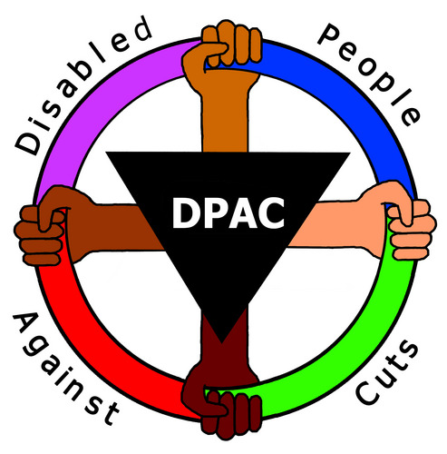
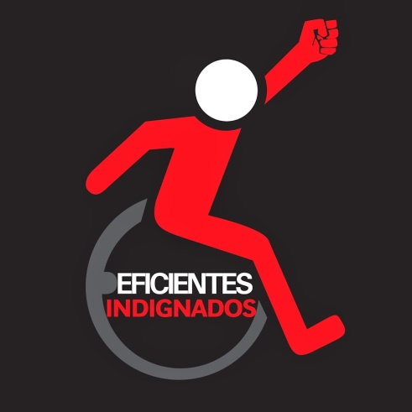
Protests and mobilizations against austerity

Slide 3
What was the 15M?
Functional diversity committees in the 15M
What do they contribute to disability activism?
What do they contribute to 15M movement?
The aftermath of the events.
Conclusions

Slide 4
What was 15 M?
Several civil society platforms called for a demonstration across Spain on May 15th 2011.
Main demand was a radical change against:
Political corruption
Unemployment
Welfare cuts
Governmental support received by banks
Democratic deficit of Spanish institutions

Slide 5
What was 15 M?
At the end of the demonstration in Madrid, at Puerta del Sol, a small group of people decided to camp until the May 22nd (day of the regional and local elections).
The number of protesters increased as the police tried to evict them two days after, and many other squares were occupied in Spain.

Slide 6
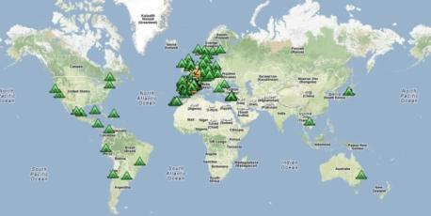
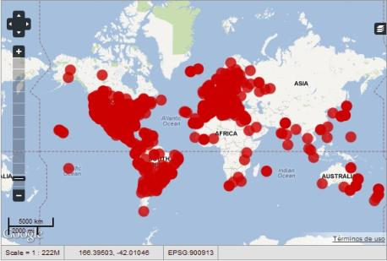
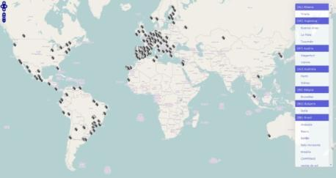
What was 15 M?
The social media immediately spread the news all over the world. The camps were replicated in several countries.
Some general traits of the movement:
SUBJECTIVITY: diversity, transparency and open confrontation
DELIBERATION : consensus and ideological contamination
MAKING SQUARE: occupy public space
POLITICS OF ANYONE (Fernandez –Savater) : participation open to anyone
Occupied Squares
June, 2nd 2011
Demonstrations and protests
October, 15th 2011
Demonstrations and protests
May, 12 -15th 2012

Slide 7
Functional diversity committees
FD committees: working groups on disability topics, created in Madrid and Barcelona 15M camps.
New partnerships and practices in disability activism: overcoming traditional atomization based on the medical model.
Reformulating the 15M movement: can it really be a truly accessible movement?

Slide 8
a) What do the committees contribute to disability activism?
What do they contribute to disability activism?
background
70s - First politicized disability associations (transition to democracy).
80s: depolitization as associations became service providers of the new Welfare system.
…………..
1997: Creation of CERMI, Spanish platform of disability organizations. Lobbying, through institutional channels.
2001: Independent Living Forum: virtual community based on self-organization, empowerment, human rights, experienced-based knowledge.
...........
2010: decline of the Independent living movement: discouragement of protests and new memberships.

Slide 9
a) What do the committees contribute to disability activism?
What do they contribute to disability activism?
The concept of “functional diversity” was coined by the FVID in 2005 to remove the negative connotations attached to the term "disability", that also replaces the concept of “impairment” by "difference".
Laboratory for generating a new common struggle: overcoming atomization & fostering repolitization.
15M gave an opportunity: occupation of public space, direct participation, horizontality and transversality.
ILF had a prominent influence
adoption of the term functional diversity
“Nothing about us , without us” & “They do not represent us”: organization based on networked individuals.
impulse for the human rights paradigm → UN Convention

Slide 10
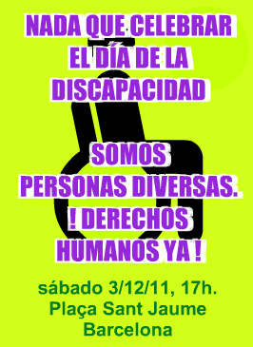
a) What do the committees contribute to disability activism?
What do they contribute to disability activism?
Celebrate December 10th, International Human Rights Day, instead of December 3rd, the International Day of Persons with Disabilities:
to distance themselves from the concept disability and the implied exclusion in designing a specific day only for people with functional diversity
a strategy to draw attention to their differences with respect to most disability institutions and organizations which take December 3rd as the strategic day to make their claims and political demands public and move to the street.

Slide 11
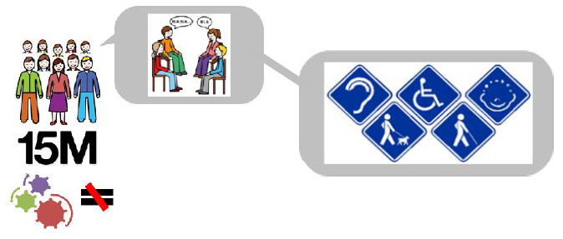
a) What do the committees contribute to disability activism?
What do they contribute to 15M movement?
Accessibility for being present and visible
The body in the square
Vulnerability in the politics of anyone

Slide 12
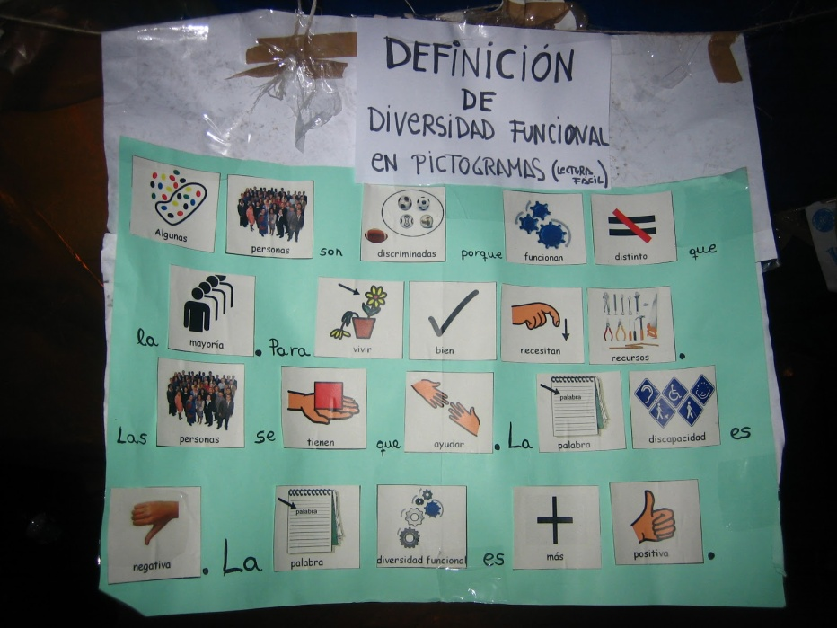
a) What do the committees contribute to disability activism?
Accessibility for being present and visible
1) Being present and visible in the squares and in virtual spaces:
first meetings: only face-to-face , in accessible and visible places and not segregated.
- hanging posters with information of the commission at different points of the camp.

Slide 13
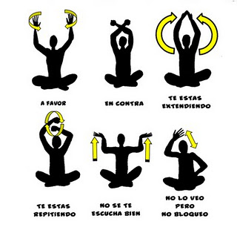
a) What do the committees contribute to disability activism?
Accessibility for being present and visible
2) Accessibility struggle
The 15M assemblies adopted some signs inspired by the Spanish Sign Language (LSE): e.g. the gesture of applause as “in favor of”.
Many other conflicts regarding accessibility:
assemblies and transversal meetings in non-accessible venues
uses of symbols in virtual communication that are not compatible with screen readers.

Slide 14
a) What do the committees contribute to disability activism?
The body in the square
Bodies are always present in political protests, both in an active (to execute action and/or carry symbols) and passive dimension (needs: food, hygiene, resistance, sleep, mobility, etc).
Occupying a public square required a strong bodily commitment → care infrastructures in the camps (food, cleaning, nursing services and non-violence) and norms (non-violent protests).
Any type of body invited to join the protest, not just the stereotype: the active presence of women, children, elder or disabled people was always celebrated as a sign of inclusivity, transversality and non-violent protest.

Slide 15
a) What do the committees contribute to disability activism?
The body in the square
- He replied with a declaration:
“I am neither a hero nor a victim, not a “borroka” (agitator) or, much less, an unconscious. I am only another outraged person . I participate in daily activities in the Catalonia square (…) I am fed up of having my presence challenged: It is my right, and even my duty, to be there as outraged (…) everyone is equal before the law and has the same rights to demonstration and self-defence”
And what about police violence?
May 27th eviction of the Barcelona: public debate about the presence of “certain” bodies in the camp .

Slide 16
a) What do the committees contribute to disability activism?
Vulnerability in the politics of anyone
Politics of anyone: avoiding singularisation of disabled people
Austerity measures: vulnerability and precariousness are shared traits
“Human revolution”: not about partial struggles

Slide 17
a) What do the committees contribute to disability activism?
The aftermath of the events
Persistence of accessibility problems:
We would like for 15M to be a social movement that includes everyone. Right now it is as inaccessible as society. There are obstacles preventing the participation of many people. We understand that it is very difficult to cover everything but we see communication or architectural barriers in many assemblies. (…) [Functional Diversity Group, 20th March 2012].

Slide 18
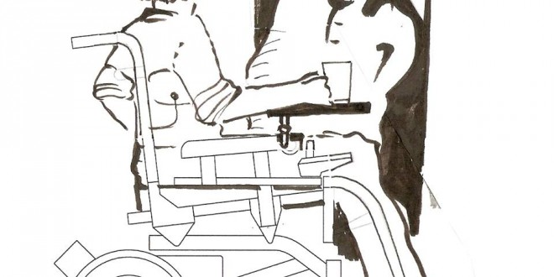
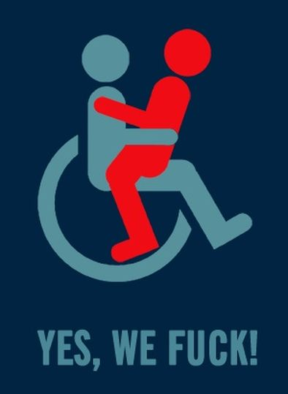
a) What do the committees contribute to disability activism?
The aftermath of the events
Creation of new alliances and activist projects, introducing new topics in disability activism:
Entorno a la silla
DIY assistive technology
Yes, we fuck!
Sexuality, feminism and disability

Slide 19
a) What do the committees contribute to disability activism?
The aftermath of the events
Political impact:
CERMI’s action is not of belligerence against a Government or an Administration, but greater public presence and visibility to prevent the collapse of the systems and devices for the promotion and protection of disabled people and their families (2012)

Slide 20
a) What do the committees contribute to disability activism?
The aftermath of the events
Political impact:
Pablo Echenique elected as European MP in 2014: blogger about disability topics.
Creation of Podemos Discapacidad Circle.

Slide 21
a) What do the committees contribute to disability activism?
CONCLUSIONS
Austerity measures: the context for renewing disability activisms in Spain:
Traditional associative movement: preservation, concerned with their economic sustainability.
Peripheral groups: exploration of new forms and topics.
15M allowed new alliances but also raised the problems for disabled to participate as equals in transversal protests: risks of reproducing traditional segregation.

Slide 22
THANK YOU FOR YOUR ATTENTION!!!
miriamarenas@ub.edu

