Slide 1
Fathers and children with disabilities. «Knowing how to wait» Roberta Caldin and Alessia Cinotti
Questioning contemporary societies
through the lens of disability
4th Annual Conference of ALTER-ESDR
Paris – France, 2-3 July 2015

Slide 2
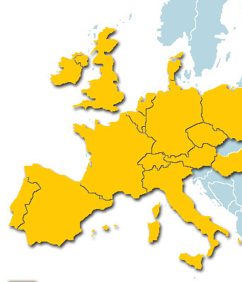
The places of the research
Bologna University (Italy)
Roberta Caldin e Alessia Cinotti
Roma3 University (Italy)
Fabio Bocci e Francesca M. Corsi
Padova University (Italy)
Simone Visentin
Université Catholique
de Lyon (France)
Margherita Merucci

Slide 3
University → Early childhood services
Bologna University
with the collaboration of the Municipality
of Bologna City
(Department of Education and School)
15 nursery school
(0-3 years old)
25 kindergarten
(4-6 years old)

Slide 4
Early childhood services → Fathers (sample)
89 fathers with a disabled son or daughter:
with a «certificazione di integrazione scolastica» according to Law 104/92;
aged 0-6 years old.

Slide 5
The research questions
« Who » are fathers of disabled children?
2. What are the main tasks (education) in an ordinary day for fathers? What do fathers really do?
3. Are fathers able to do bring something «different» from mothers in the education of their children?

Slide 6
First point
The educational relationship between a father and his disabled child is not so different from the educational relationship between a father and his no-disabled child (common aspects and educational dimensions)

Slide 7
Second point
Fathers and the maternal dimension
The involvement and engagment of fathers in daily care routine, protection and affective role, emotional proximity, unconditional satisfaction of the needs of children etc.
Fathers and the paternal dimension
The exercise of paternal function, rules, boundaries, a sense of limits, waiting times etc.

Slide 8
Daily care

Slide 9
Affective dimension

Slide 10
Words

Slide 11
Rules

Slide 12
Learning

Slide 13
Third point: knowing how to wait
Fathers, more so than mothers, appear sufficiently able to bring emancipating elements to the relationship with the child. Fathers knowing how in their own personal fatigue to calibrate the assistance given to the child, without exceeding in a cumbersome parental presence. Like in a game of mirrors, the child can in turn learn to “know how to be” in his own frustration, learning to manage his fears and his efforts, in a protected context like that of the family.

Slide 14
Thank you!
Email: roberta.caldin@unibo.it
Email: alessia.cinotti2@unibo.it

