Slide 1
Supporting vocational activity of people with intellectual disability in Poland
Agnieszka Woynarowska
Iwona Lindyberg
Paris July, 2015

Slide 2
Agenda
1.
3.
4.
2.
Social policy for adults with intellectual disabilities in Poland
Social support network for adults with intellectual disability
Supported Employment Projects
Stong and weak points of Polish Supported Employment Projects

Slide 3
Social policy for adults with intellectual disability in Poland
Social inclusion
Countering exclusion and discrimination
Building a support system
Can participate in everyday life

Slide 4
UN Convention
on the Rights of Persons
with Disabilities
2012

Slide 5
The change of perception of adulthood of persons with intellectual disability
A person with disability is no longer perceived only as a sum of deficiencies and disabilities
A grown-up person with disability deserves just as many education opportunities as a disabled child
Improving the quality of life of an adult person with disability is the main aim of the social policy

Slide 6
Rights of persons with intellectual disability:

Slide 7
Have their own independent lives

Slide 8
Be given support

Slide 9
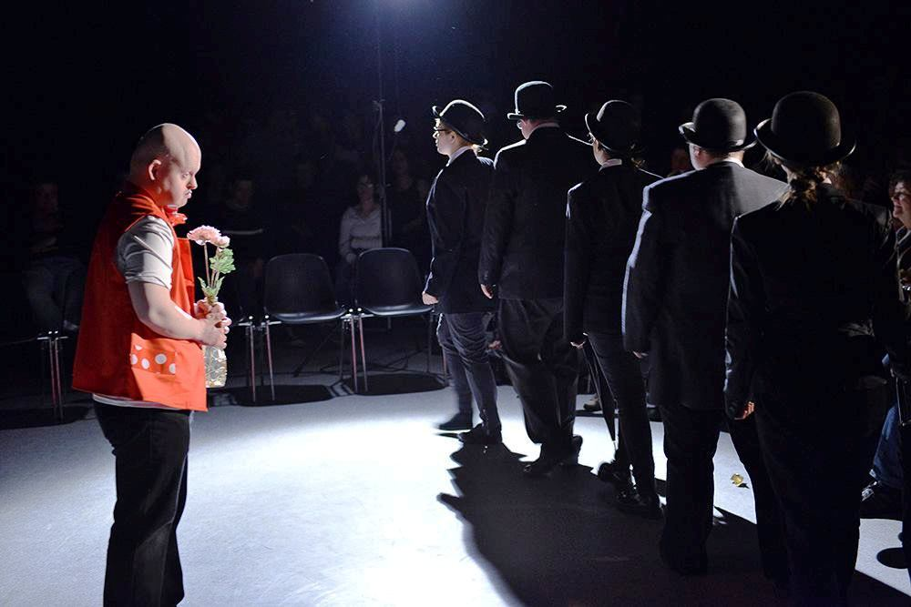
Develop themselves

Slide 10
Pursue professional activity

Slide 11
Social support nertwork for adults with intellectual disability in Poland
Supported Employment Projects
WTZ
ŚDS
ZAZ
Mieszkania chronione
Occupational Therapy Workshops
Community Self-help homes
Vocational Development Centres
Supported flats
Notes:
Adulthood support services are provided in a number of institutions which build a social support network within local communities.

Slide 12
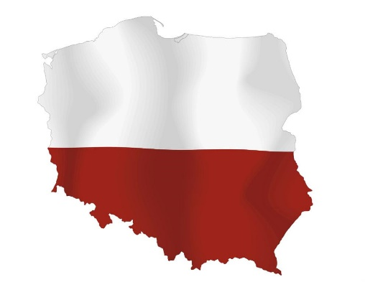
Supported Employment Projects
Implemented in Poland since 2002
Non-governmental organizations (Polish Association for Intellectual Disabilities)
Polish Union of Supported Employment was established in 2014

Slide 13
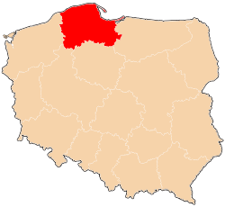
Supported Employment Projects in Gdańsk
Since 2006
Biuro Integracji Zawodowej Osób Niepełnosprawnych- The Professional Support Office for Persons with Disabilities
Centrum Ster Zawodowy - Professional Career Centre

Slide 14
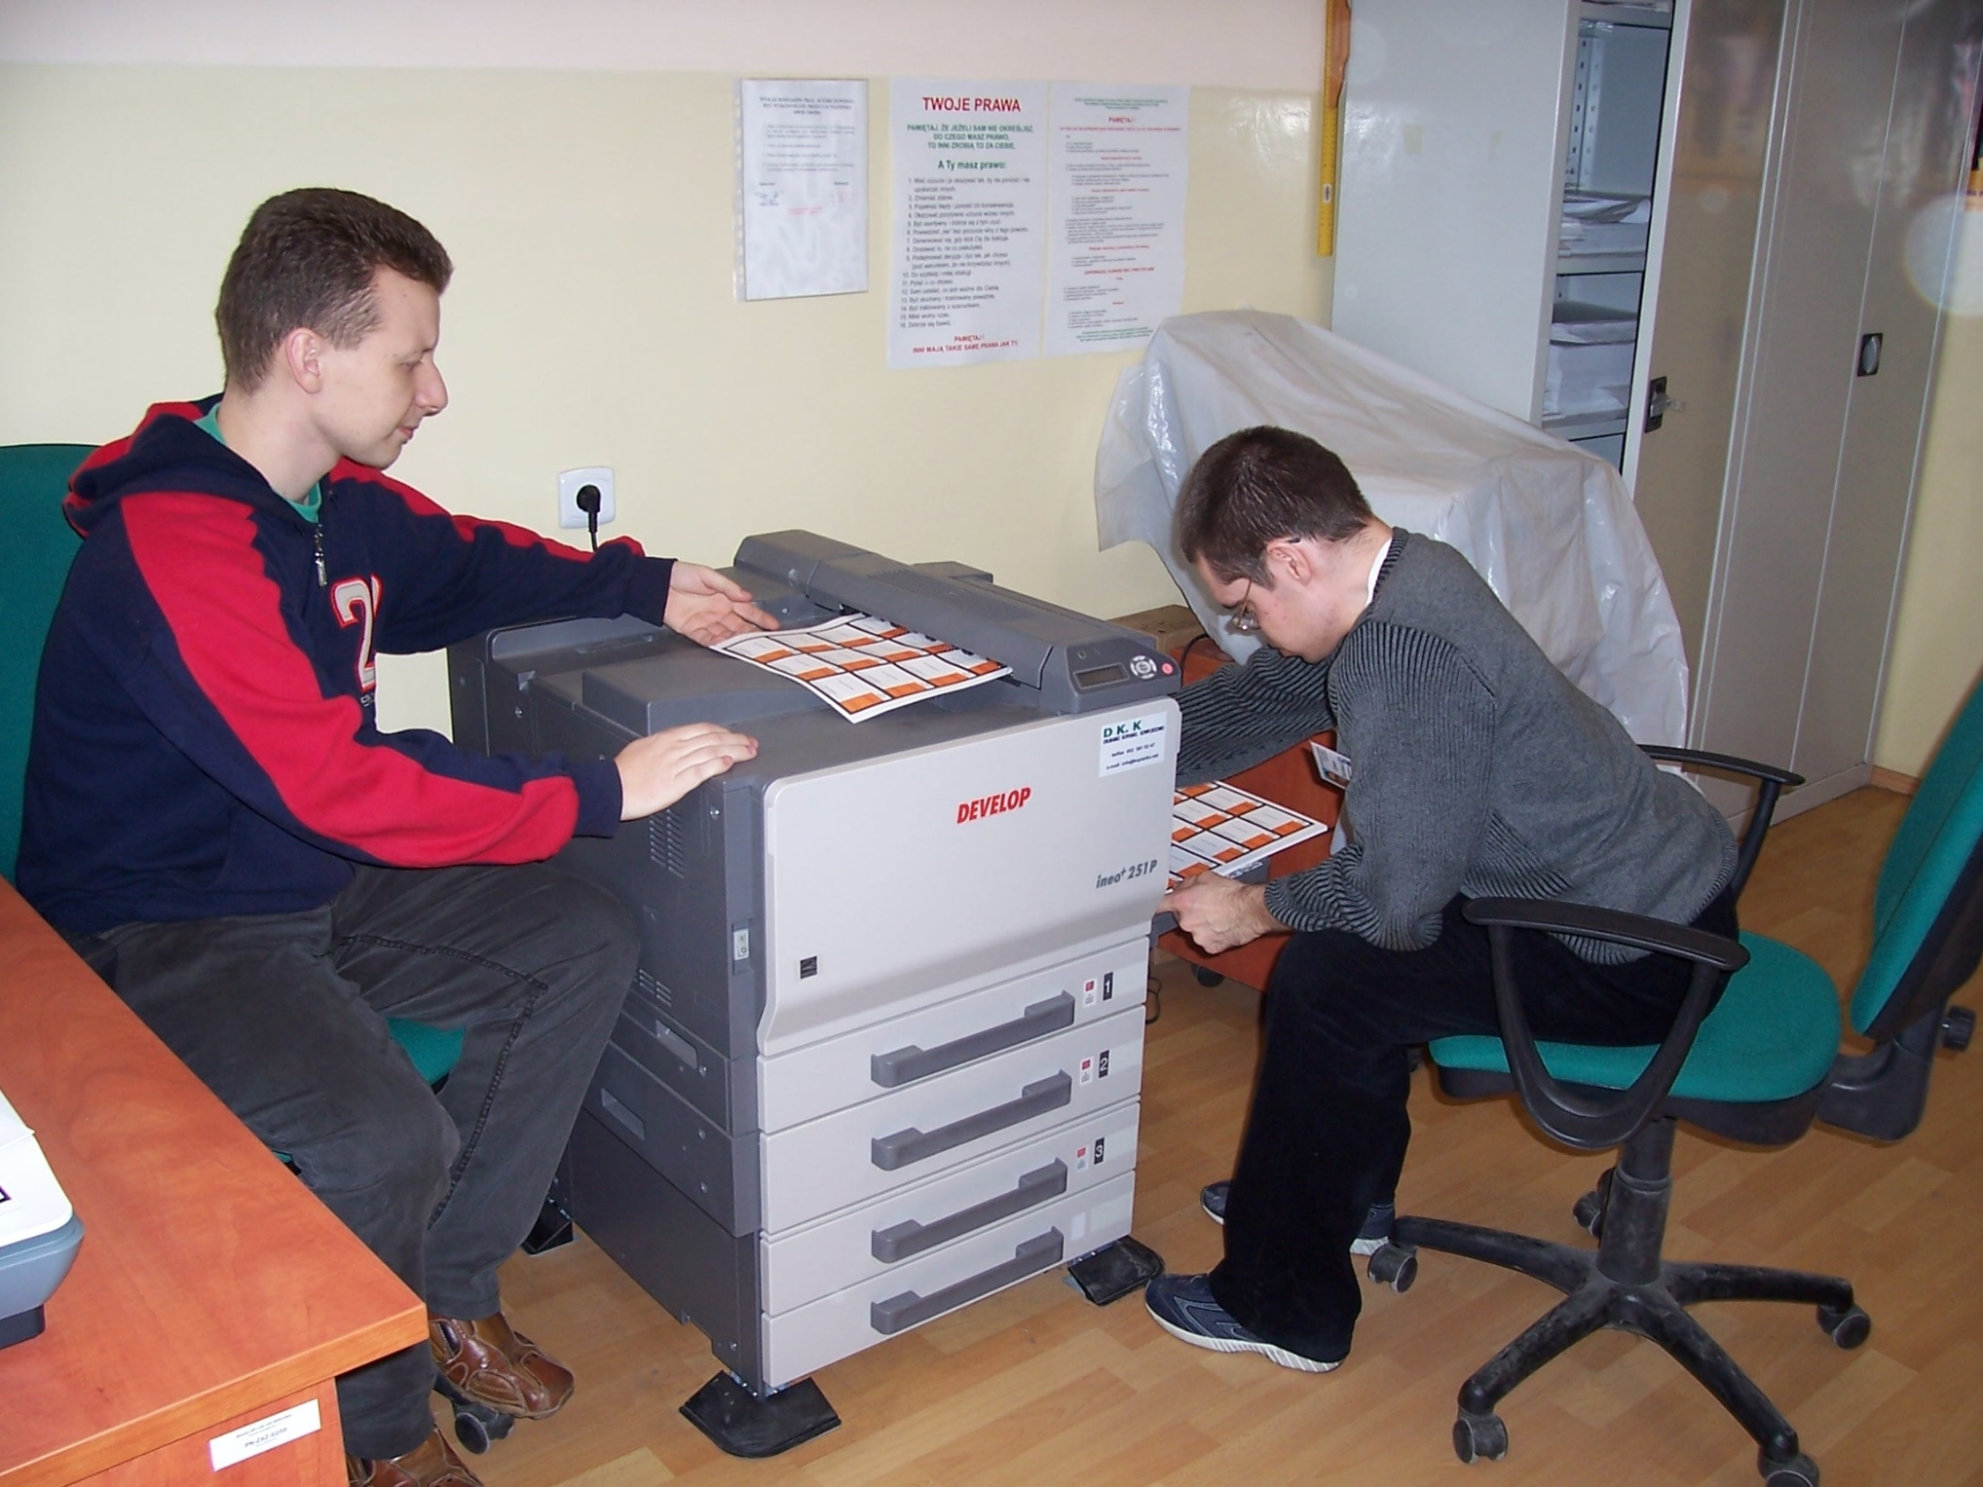
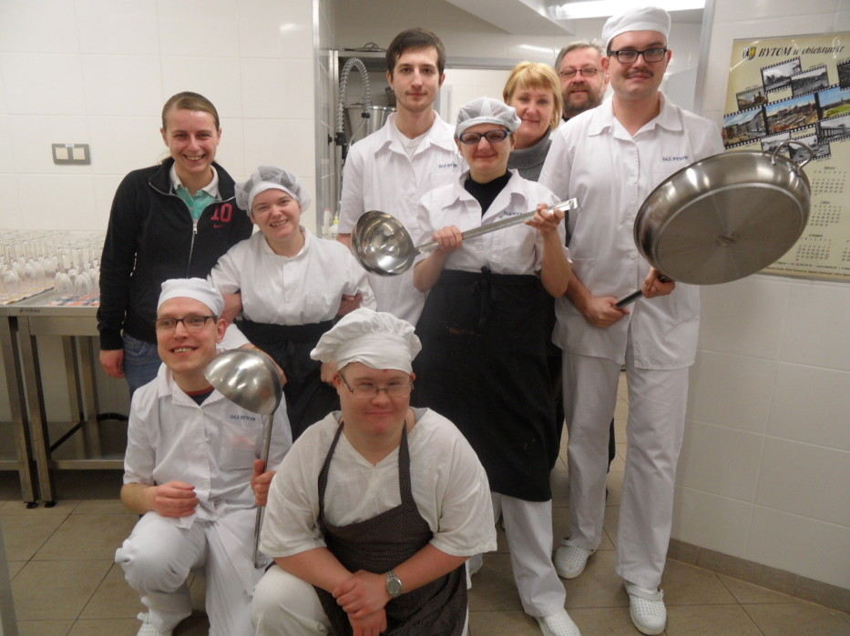
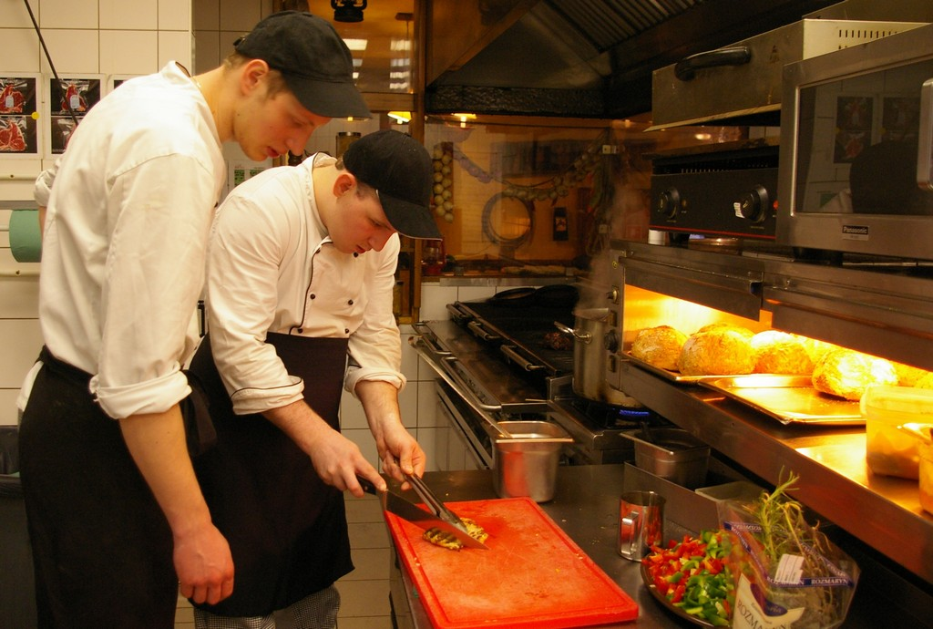
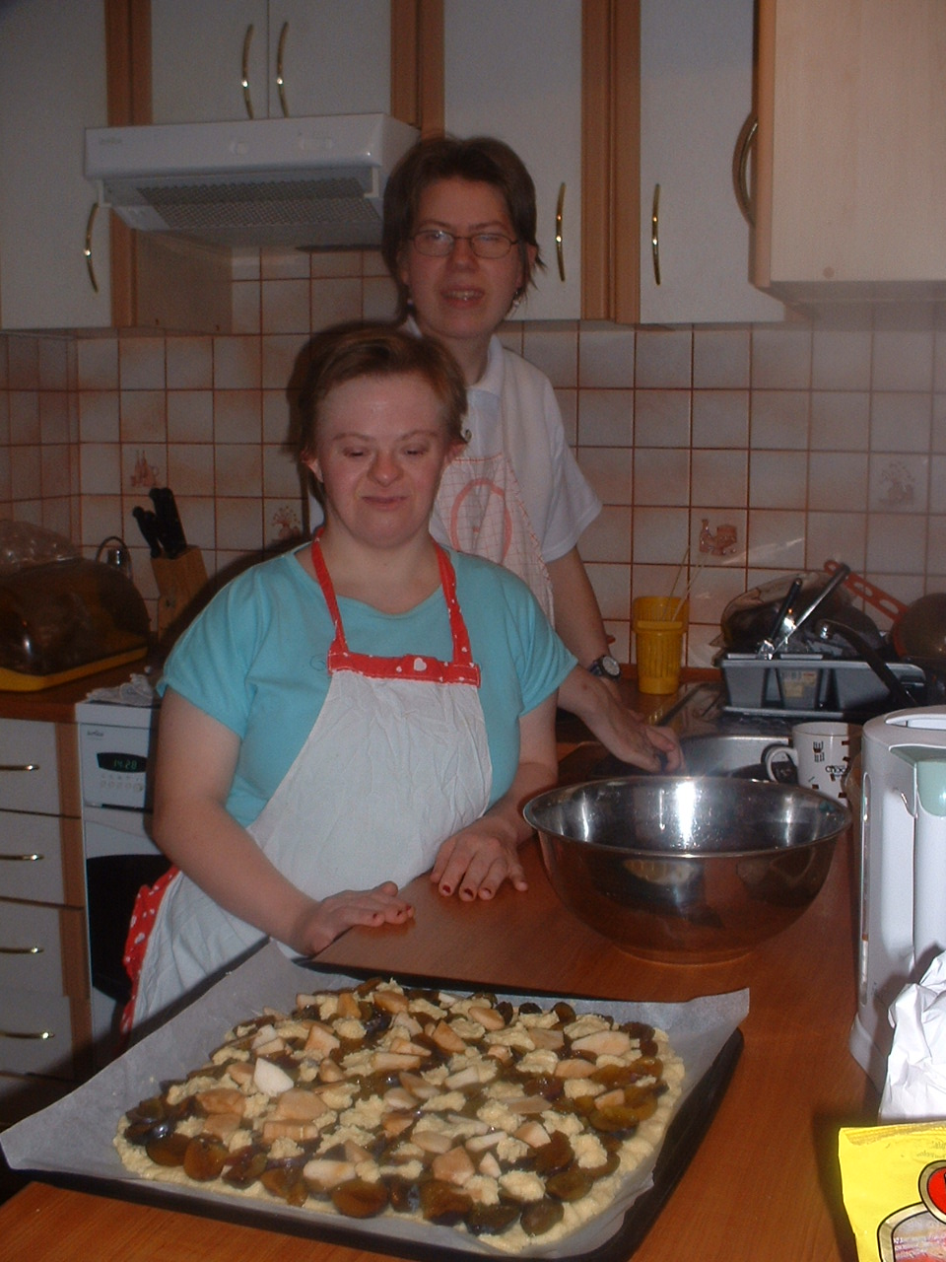
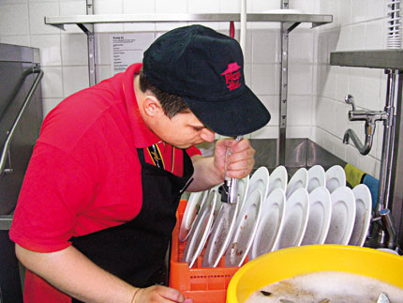
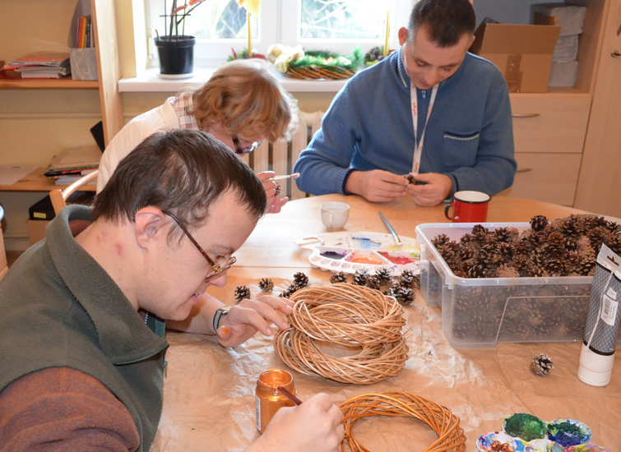
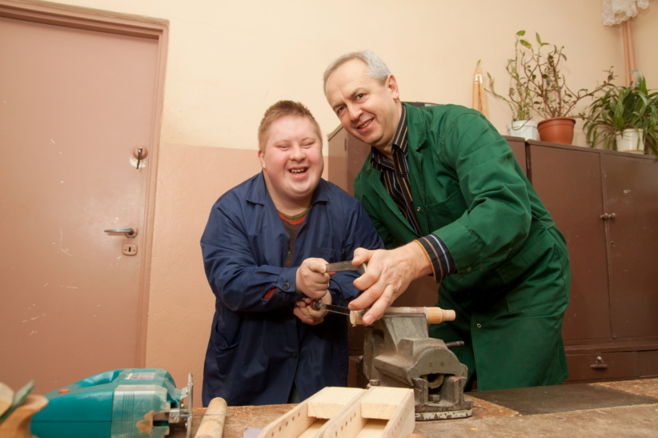
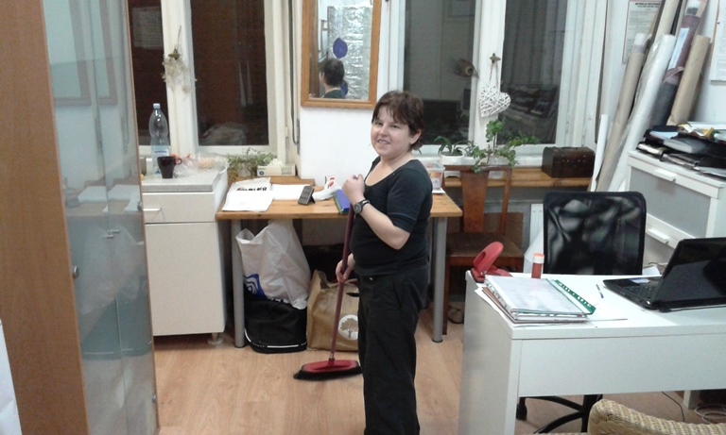

Slide 15
In the last 9 years:
200 people have taken advantage of the supported employment offices
100 people have completed coaching sessions and apprenticeships
95 people have completed internships
20 people have found a job

Slide 16
Supported Employment Projects
Strong points
Weak points

Slide 17
Weaknesses
Lack of strategic framework for supported employment - lack of system level solutions
Lack of national level strategy of including supported employment into the mainstream employment
Lack of regulation (currently being developed)
Lack of targeted funding for the policy on supported employment
Supported Employment services are provided on a project basis. Therefore, it is difficult to ensure continuity of projects and raise funding.
Difficulties in attracting employers because of the stereotypes associated with persons with disabilities.
Lack of family support

Slide 18
Strengths
Prevents the intellectually disabled from being excluded from paid employment
Reasserts the role of a disabled person as a worker, helps create their positive social image, breaks social barriers
Improves the social status of persons with intellectual disability

Slide 19
What project participants say
I’m doing my best. An employee must work. An employee should be brave, reliable and trustworthy. I work in order to achieve my goals, which are varied. One of them is to make other people happy.
I want people to know that I am a person with disability and work in the office.
Work is important for me. I need it to earn money for my expenses.

Slide 20
Attracting new employers
Creating positive social image, and breaking social barriers
Our future aims are
Promoting the Supported Employment

Slide 21
Thank you for your attention
Agnieszka Woynarowska
a.woynarowska@ug.edu.pl
Iwona Lindyberg
iwona.lindyberg@ug.edu.pl

